Slide 1
Constitutional Law II
Individual Rights
Prof. Karl Manheim
June 11, 2016
http://www.lls.edu/jls/2016
copyright © 2016 – Karl Manheim

Slide 2
Types of Cases in Sup. Court
Federalism
Separation of Powers
Individual Rights
Statutory Rights
Other (rarely)
International
State
Common Law
Thursday

Slide 3
Case Studies (from 2011-2015 terms)
Fundamental Rights
Obergefell v. Hodges (2015) – Same-Sex Marriage
Whole Women’s Health (pending) –Abortion
Equal Protection
Fisher v. U Texas II (pending) – Affirmative Action
First Amendment
Brown v. EMA (2015) – Video Violence
Elonis v. Alvarez (2016) – True Threats
McCullen v. Coakley (2014) – Buffer Zones
Walker v. Conf. Veterans (2015) – Gov’t Speech

Slide 4
Case Studies (from 2012-2015 terms)
Religion
Town of Greece v. Galloway (2014) - Prayer
Religious Freedom Restoration Act
Burwell v. Hobby Lobby (2014) – Obamacare
Zubik v. Burwell (2016) – Obamacare

Slide 5
Roadmap to Individual Rights
Is the right at stake fundamental for constitutional purposes?
If so, is the right burdened by the state?
If so, apply “strict scrutiny”
If not (Q1 and 2), apply “rational basis”

Slide 6
Origin of Individual Rights
In the beginning …
Colonists supposedly enjoyed the same rights as English subjects (unwritten constitution)
As State governments replaced the Crown, we were given rights in state constitutions
The limited federal government did not displace our State rights
Protection from federal abuses was thought to be secure in the structure of the national gov’t
Federalism
Separation of Powers

Slide 7
Sequence of Constitutional Rights
Original Constitution (1787)
Art. I, § 9 (applies only to federal gov’t)
Right of slave trade
Habeas corpus
Bill of Attainder
Ex Post Facto Laws
Art. I, § 10 (applies only to states)
Contracts clause
Bill of Rights (1791) (applies only to fed’l gov’t)
Civil War Amendments (1865-1870) (states)
Other Amendments – mostly voting rights
Notes:
12th: election of president
15th: race
17th: senators
19th: sex
23rd: DC
24th: poll tax
26th: age

Slide 8
Principal Constitutional Rights
1st Amendment
Religion, Speech
2nd Amendment
5th Amendment
Due Process, Taking
13th Amendment
14th Amendment
Citizenship, DP,
Privileges/Immunities, Equal Protection
Voting Rights (12, 15, 17, 19, 23, 24, 26)
4th Amendment
Search & seizure
5th Amendment
jeopardy, self-incrim
6th Amendment
counsel, trial
8th Amendment
not fully incorporated

Slide 9
Why “Incorporate” the BoR?
Bill of Rights restrains federal gov’t only
Protection from state abuse per state law
often more theoretical than real
Then the Civil War …
dramatized lack of rights under state law
One purpose of 14th was to “federalize” rights
BoR through the 14th applies to the states
“No State shall make or enforce any law which shall abridge the privileges or immunities of citizens of the United States; nor shall any State deprive any person of life, liberty, or property, without due process of law, nor deny any person within its jurisdiction the equal protection of the laws.”

Slide 10
Anatomy of Individual Rights
Fundamental rights
Sourced in the constitution
Sourced externally (e.g., natural law)
challenged law is presumed invalid
Infringement of fund’l rights is subject to strict scrutiny
Government interest (ENDS) must be compelling
Challenged law (MEANS) must be narrowly tailored
Non-Fundamental rights
Statutory rights
State-created rights
Int’l / Humanitarian Law rights
challenged law is presumed valid
Non-fundamental rights get rational basis review
Government interest (ENDS) must be legitimate
Challenged law (MEANS) must be rationally related

Slide 11
What Rights are “Fundamental”?
Textual rights
Non-textual rights
5th/14th Amds: deprivation of life, liberty, or property, without due process of law
Procedural component
Substantive component
"so rooted in the traditions and conscience of our people as to be ranked as fundamental"
“fundamental to the American scheme of justice”
notice how subjective these are

Slide 12
Obergefell v. Hodges (2015)
Questions Presented:
Does the Fourteenth Amendment require a state to license a marriage between two people of the same sex?
Does the Fourteenth Amendment require a state to recognize a marriage between two people of the same sex that was legally licensed and performed in another state?

Slide 13
Obergefell v. Hodges (2015)
Fundamental Rights Analysis
Marriage held fund’l in Loving v. VA (1967)
invalidating state anti-miscegenation law
Is same-sex marriage also fundamental?
per history & traditions of American people
Court is loathe to create new fund’l rights
Right to Marry is Inherent in Autonomy
Among most intimate individual decisions
Safeguards commitment, children, families
Keystone of nation’s social order
Denial of a right is per se burdensome
no difference between same and opposite sex couples

Slide 14
Obergefell v. Hodges (2015)
Equal Protection Analysis
Are gays & lesbians a “suspect class”?
Indicia of suspectness
history of purposeful discrimination
political powerlessness
immutable trait
discrimination against class is grossly unfair
EP Clause Also Protects Fundamental Rts
from disparate treatment
unnecessary to show undue burden
rights can be fundamental for EP purposes even if not DP

Slide 15
Obergefell v. Hodges (2015)
Rational Basis Standard (per 4th Cir)
Legitimate state interests:
marriage designed to promote/regulate procreation
preserve cultural & historical norms
Plausible (rational) means:
limiting marriage to heterosexuals does not always promote these state interests, but it is not irrational
Rational Basis Standard (per Kennedy)
Animus against disfavored class per se invalid
U.S. v. Windsor (2013) - DOMA
Lawrence v. Texas (2003) – Texas sodomy law
rational basis with bite

Slide 16
Obergefell v. Hodges (pending)
Questions Presented:
Does the Fourteenth Amendment require a state to recognize a marriage between two people of the same sex that was legally licensed and performed in another state?
Full Faith & Credit Clause (Art. IV)
is there a public morality exception?
unnecessary to answer (since Q1 is yes)
“Full faith and credit shall be given in each state to the public acts, records, and judicial proceedings of every other state”

Slide 17
Whole Women’s Health v. Hellerstedt
(pending)
Texas Abortion Law (H.B. 2)
Hospital & surgery standards for clinics
75% TX clinics closed (rural areas have 0)
Choice as Fundamental Right
Roe v. Wade (1973); PPP v. Casey (1992)
Are TX requirements an “undue burden”?
a substantial obstacle to exercise of right?
If yes, apply Strict Scrutiny
If no, apply Rational Basis
Undue Burden switching point is subjective
this is what 5th Circuit did

Slide 18
Race
Racial Classifications: original suspect class
Prima facie case:
Discriminatory impact (unequal outcomes)
Discriminatory purpose (de jure vs. de facto)
Facial Racial classifications
Purpose presumed; disparate impact not required
Redistricting (Ala. Leg. Black Caucus (2015))
Race as a motivating factor in gerrymandering
Affirmative Action
Fisher v. UT (2013): educational diversity
Schuette v. BAMN (2014): no right to AA

Slide 19
Fisher v. UT II (argued Dec. 9, 2015)
Issue on Remand (after Fisher I)
Assuming diversity is a compelling state interest
Is UT’s “holistic” plan “necessary” to achieve it
or does Texas’ “top ten” plan yield an adequate number of minorities for educational diversity
Consequence of 8-member Court
Court probably would not have taken the case
4-4 split will affirm Fifth Circuit (upholding AA)

Slide 20
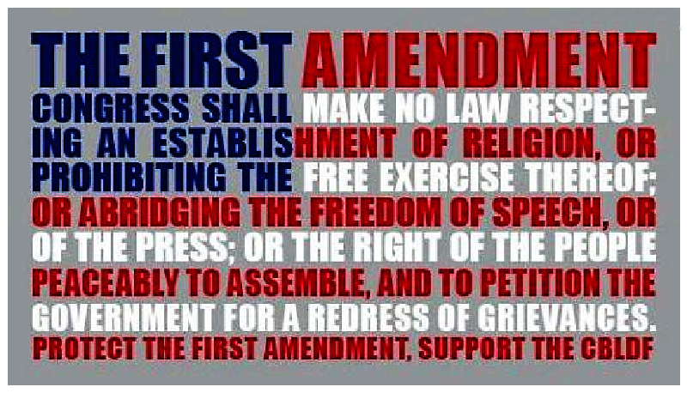
The First Amendment
1
2
3
4
5
6

Slide 21
Theories of 1st A^{md} Interpretation
“Congress shall make no law … abridging the freedom of speech, or of the press…”
Strict textualism
Hugo Black: absolute protection for speech
Rejected by Court in 2 respects:
What speech is protected?
How much is it protected?
Categories
Unprotected
Protected
Lesser Protected
few laws
perjury, libel obscenity, © ?
qualified, not absolute, right: what degree of state interest is sufficient to suppress speech?

Slide 22
Categories of unprotected speech
at various times
Subversion
Incitement of imminent lawlessness
Solicitation of crime
Defamation
Fighting Words
Vulgarity & Violence
Hate Speech (“group libel”)
True threats of harm
Obscenity

Slide 23
Categories of unprotected speech
Subversion
Incitement of imminent lawlessness
Solicitation of crime
Defamation
Fighting Words
Vulgarity & Violence
Hate Speech (“group libel”)
True threats of harm
Obscenity

Slide 24
Brown v. EMA (2011)
Sale of violent video games to minors
Images of killing, maiming, dismembering, sexually assaulting human
If appeals to deviant/morbid interest of minors
And lacks serious value

Slide 25
Brown v. EMA (2011)
Video games are protected speech
Unless content is otherwise banned
Sexual violence is not same as obscenity
Interactive gaming ≠ incitement of conduct
Categorical balancing
Violent speech may be socially useful (literary)
State’s parens patriae interest < 1st amd value
Ad hoc balancing (via strict scrutiny)
State can’t show ban narrowly tailored to avoid psychological harm to minors or social deviancy
Fails MEANS test

Slide 26
Brown v. EMA (2011)
Thomas (dissenting)
Children lack 1st Amd protection (originalism)
Breyer (dissenting)
Not facially unconstitutional (not always invalid)
Video games are part action, part speech
California has compelling interest
Promote parental supervision of children
Parens patriae interest in well-being of youth
Statute “significantly furthers” state’s interest
No “less restrictive alternative”
Several cases hold that state has greater latitude in restricting speech to minors

Slide 27
Categories of unprotected speech
Subversion
Incitement of imminent lawlessness
Solicitation of crime
Defamation
Fighting Words
Vulgarity & Violence
Hate Speech (“group libel”)
True threats of harm
Obscenity

Slide 28
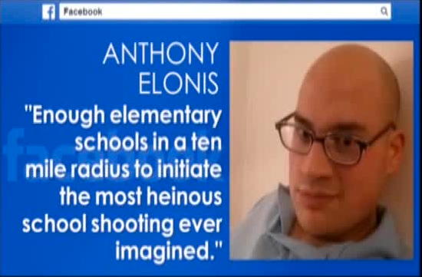
Elonis v. U.S. (2015)
18 U.S.C. §875(c) bans “threats”
“True threats” are “unprotected” speech
Does “threat” require “subjective” intent?
harm may result from objective threat even without intent
Holding
Criminal statutes typically require mens rea
intent to commit the proscribed act or knowledge

Slide 29
Time, Place & Manner
Most speech is mixed with conduct
e.g., protests, signs, soliciting
Lesser scrutiny for regulation of conduct
Time, Place & Manner test
Is the regulation content neutral?
Is it narrowly tailored
To serve a significant state interest, and
Leaves open alternative avenues of comm’n
Public Forum Doctrine
no right of speech access in non-public forum

Slide 30
McCullen v. Coakley (2014)
Mass. Gen. Laws ch. 266, §120E ½(b) (2007)
”No person shall knowingly enter or remain on a public way or sidewalk adjacent to a repro-ductive health care facility” within a designated and clearly marked 35 foot buffer zone.
§120E ½(c) - Exemptions
Persons entering or leaving the facility
Employees acting within scope of employment
Public safety and municipal personnel
Passersby

Slide 31
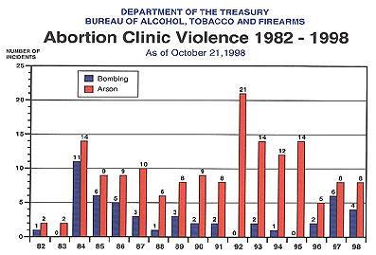
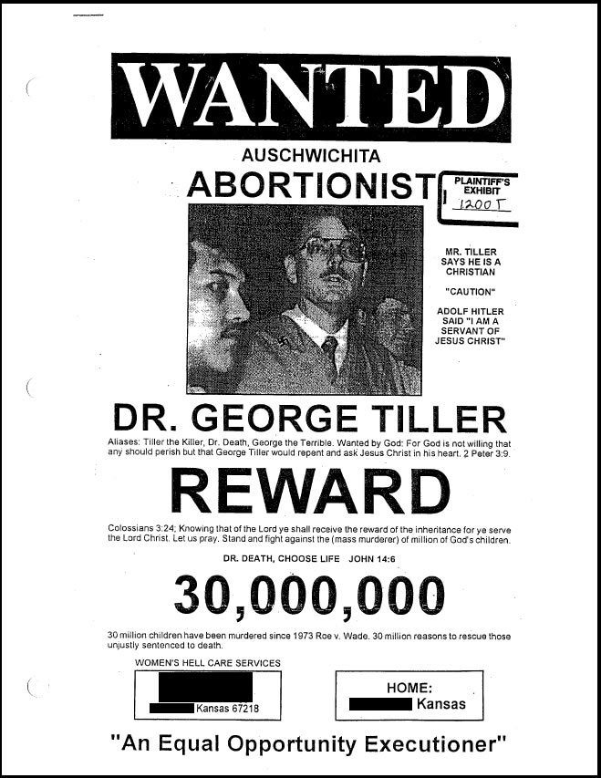
Background
Mass. Legislature findings
Widespread violence outside abortion clinics

Slide 32
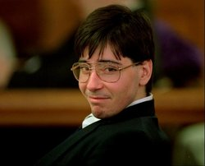
Background
Incidents of clinic violence since 1977:
8 murders
17 attempted murders
42 bombings
181 arsons
thousands of other incidents
Massachusetts
1994 - John Salvi killed 2 workers and injured 5 others at Planned Parenthood in Brookline, Mass, and Norfolk, VA.
Mass enacts Public Safety at Reproductive Health Care Facilities law in 2000
Notes:
source: Vicki Saporta, president of the National Abortion Federation (NAF)

Slide 33
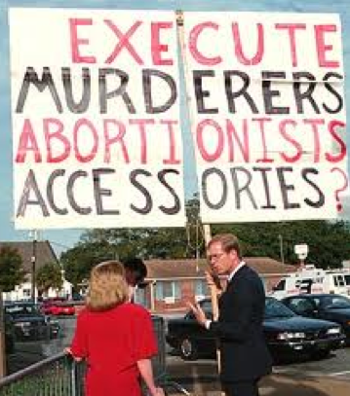
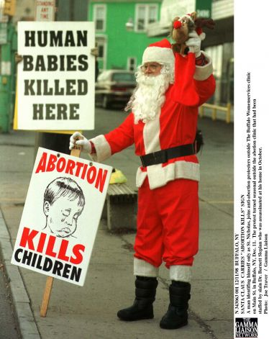
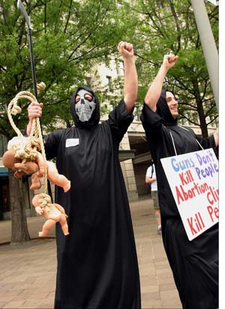
Background
Mass. Legislature findings
Aggressive behavior, harassment & intimidation

Slide 34
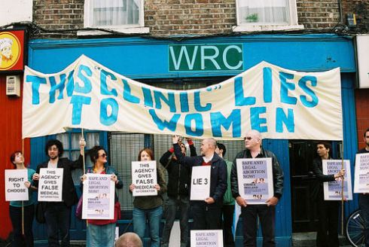
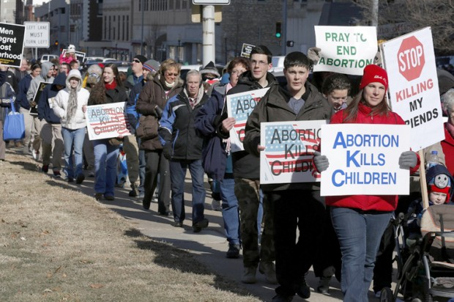
Background
Mass. Legislature findings
Peculiar vulnerability of women seeking abortion
running the gauntlet

Slide 35
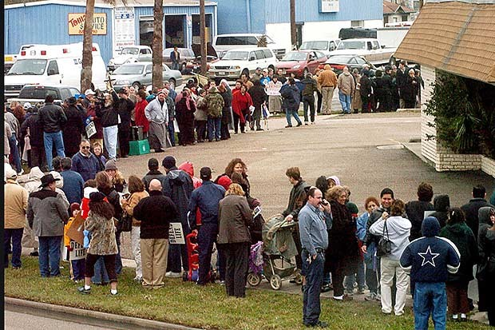
Buffer Zones

Slide 36
McCullen v. Coakley (2014)
Analysis
TP&M test applies – sidewalk is public forum
1. Is the regulation content neutral?
Yes (exceptions not based on content)
3. To serve a significant state interest
Yes, basis for law is public safety
2. Is it narrowly tailored
No, stifles more speech than necessary
4. Leaves open alternative avenues of comm’n
Yes, but not as effective

Slide 37
Walker v. Sons Conf. Veterans (2015)
Texas DMV Rejects Conf. License Plate
Gov’t Speech Doctrine
Government may speak
May express a viewpoint
Does not need to be content neutral
Are Plates Public Speech or Gov’t Speech?
Treated as conveying gov’t information
Expansive Gov’t Speech Doctrine
Gov’t may proselytize (e.g., abortion is bad)

Slide 38
Town of Greece v. Galloway (2014)
Establishment of Religion
Legislative prayer is acceptable historic practice
not an “endorsement” of religion
Sectarian prayers allowed even if all Christian
not an “endorsement’ of Christianity if reflective of community
“religious balancing” not required
Accommodation of religion allowed
so long as not endorsing or coercing

Slide 39
Burwell v. Hobby Lobby (2014)
Issues
Does the Religious Freedom Restoration Act (RFRA) protect for-profit corporations?
Does the contraceptive-coverage Mandate of the ACA violate corps’ religious exercise rights?
RFRA
Fed’l gov’t shall not substantially burden a person’s exercise of religion unless it is the least restrictive means to further a compelling gov’t interest
statutory override of Empl. Div. v. Smith (1989)

Slide 40
Burwell v. Hobby Lobby (2014)
Holding
Corporations are people too
at least closely-held corporations
in corporate personhood cases, it is management that is protected, not shareholders or employees
Providing contraceptive coverage to employees substantially burdens religious freedom
Note: this is a statutory case, not 1st Amd.
Flores v. Berne: RFRA exceeds congress’ §5 power
but not when congress limits its own power

Slide 41
Zubik v. Burwell (2016)
Does ACA Reporting Violate RFRA?
Exempt employers must notify their insurer or HHS of non-coverage for contraception
Insurers then provide direct cost-free coverage
Is reporting a substantial burden on religion
i.e., does it make the employers complicit in sin?
Holding (per curiam)
Compromise may be possible
automatic “seamless” coverage without reporting
Remand to Circuits to explore compromise

